Slide 1
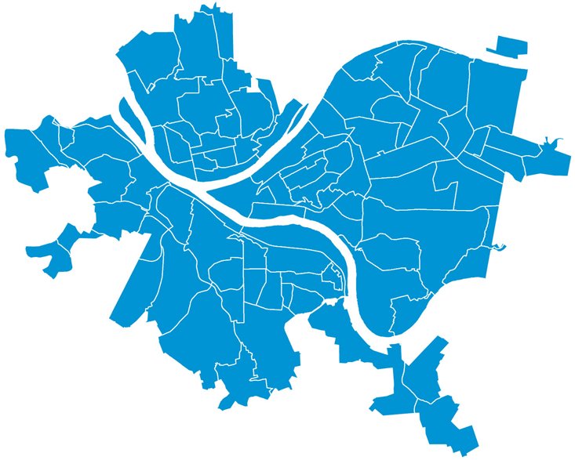


Board Meeting
July 16, 2018

Slide 2



Central Business District – 420 Boulevard of the Allies
General
Announcements
Center for Innovation and Entrepreneurship
Housing
Real Estate
Engineering and Construction
Executive
Authorization to execute an agreement of sale with 420 Allies LLC for the acquisition of Block 1-M, Lot 150, in the 1st Ward (420 Boulevard of the Allies) for $27,500,000.00.
Authorization to pay the URA’s share of the down payment on the acquisition of 420 Boulevard of the Allies in the amount of $1,666,667.00.
Issuance of a request for proposals (RFP) for design of the interior build out of the URA-occupied portion of 420 Boulevard of the Allies.
Authorization to enter into an agreement with Blank Rome LLP for an amount not to exceed $25,000.00 for legal services related to the acquisition of 420 Boulevard of the Allies.
Authorization to enter into cooperation agreements with the City of Pittsburgh and the Housing Authority of the City of Pittsburgh concerning funding and ownership matters related to the acquisition of 420 Boulevard of the Allies, including, but not limited to, a commitment to execute a guaranty and related security instruments securing a borrowing by the City of Pittsburgh by a to-be-determined lending institution in an amount not-to-exceed $40,000,000.00 to finance acquisition, design, and build out.

Slide 3
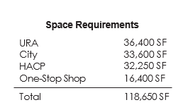
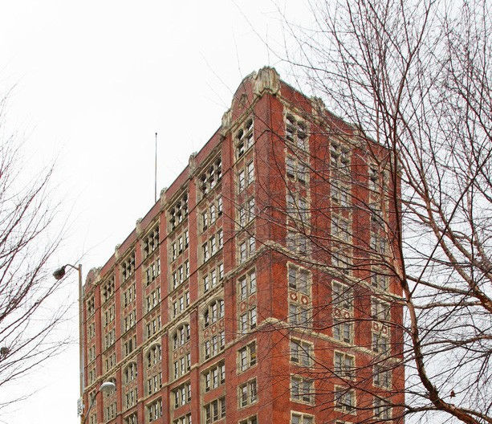
200 Ross St.
General
Announcements
Center for Innovation and Entrepreneurship
Housing
Real Estate
Engineering and Construction
Executive
200 Ross Street
Major building systems need to be replaced Renovations required to meet current codes
Building does not adequately facilitate modern workplace standards
Not customer friendly

Slide 4
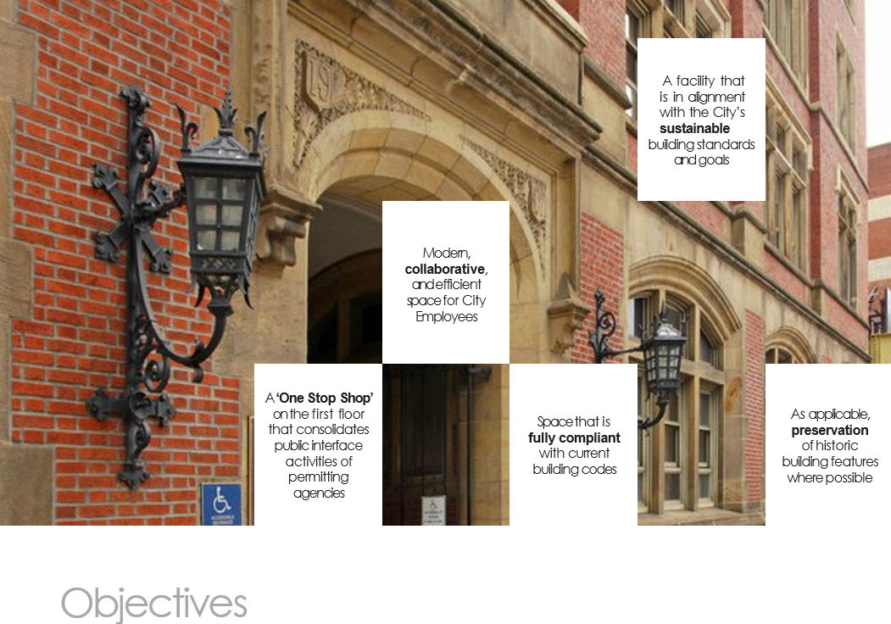
200 Ross St.
Center for Innovation and Entrepreneurship
Engineering and Construction
Announcements
Housing
Real Estate
Executive

Slide 5
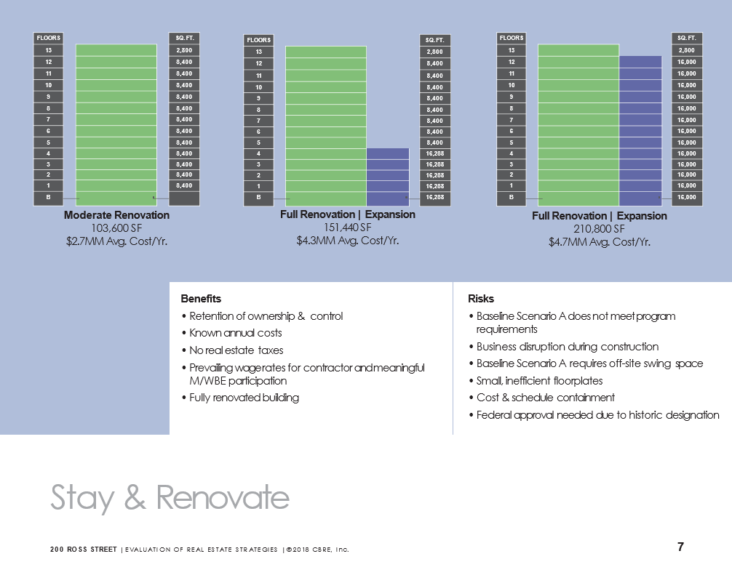
200 Ross St.
General
Housing
Real Estate
Engineering and Construction
Executive

Slide 6
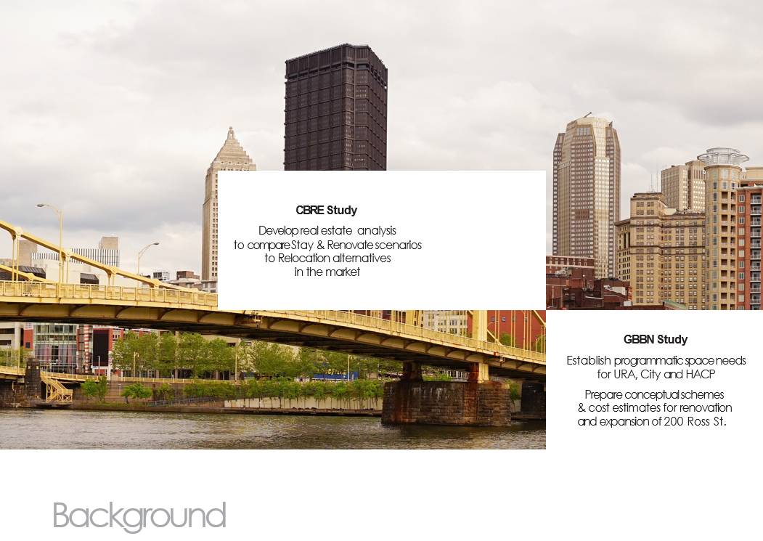
General
Announcements
Center for Innovation and Entrepreneurship
Housing
Real Estate
Engineering and Construction
Executive

Slide 7
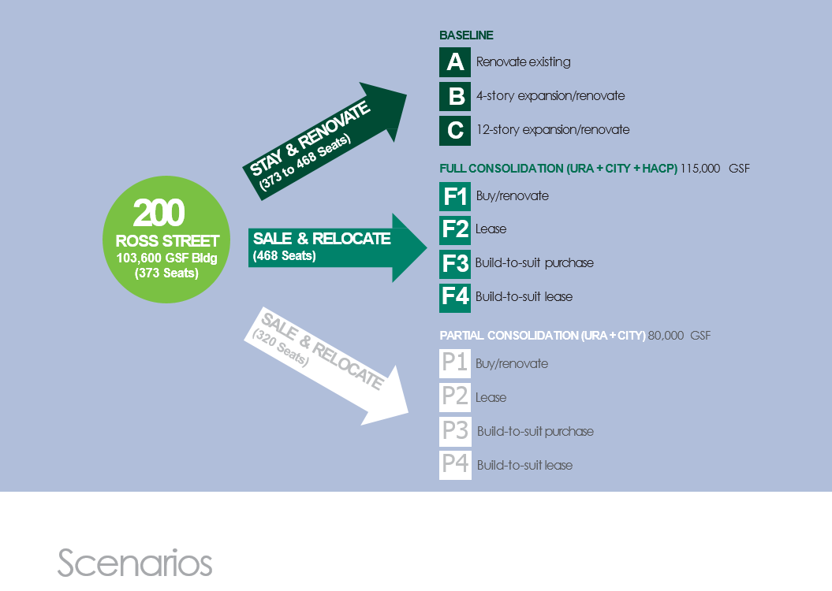
General
Announcements
Center for Innovation and Entrepreneurship
Housing
Real Estate
Engineering and Construction
Executive

Slide 8
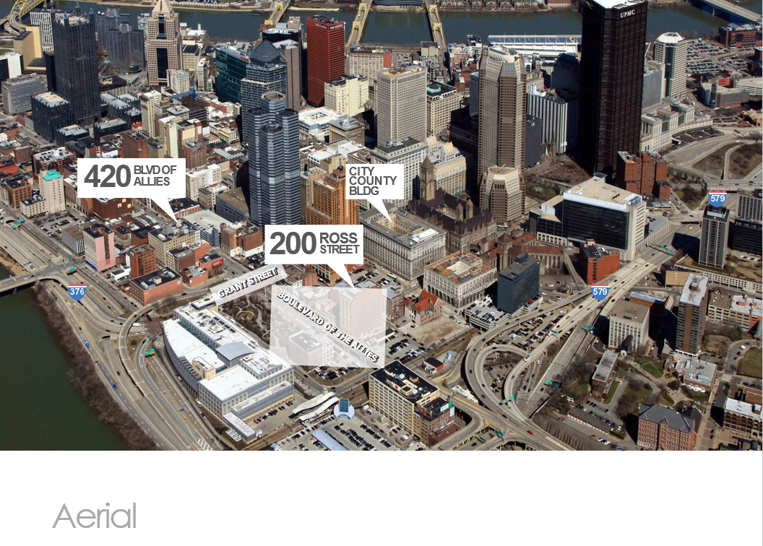
General
Announcements
Center for Innovation and Entrepreneurship
Housing
Real Estate
Engineering and Construction
Executive

Slide 9
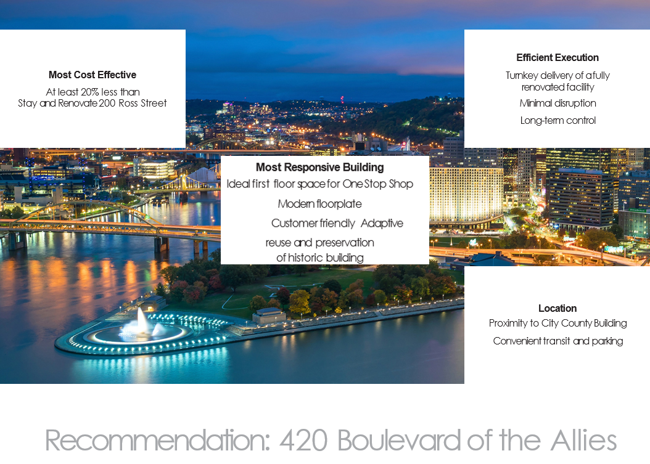
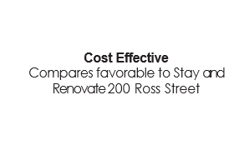
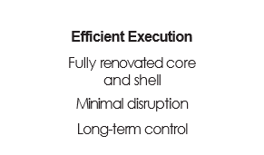
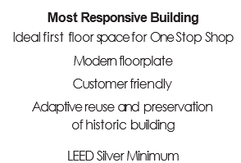
420 Blvd of the Allies
General
Center for Innovation and Entrepreneurship
Housing
Real Estate
Engineering and Construction
Executive

Slide 10
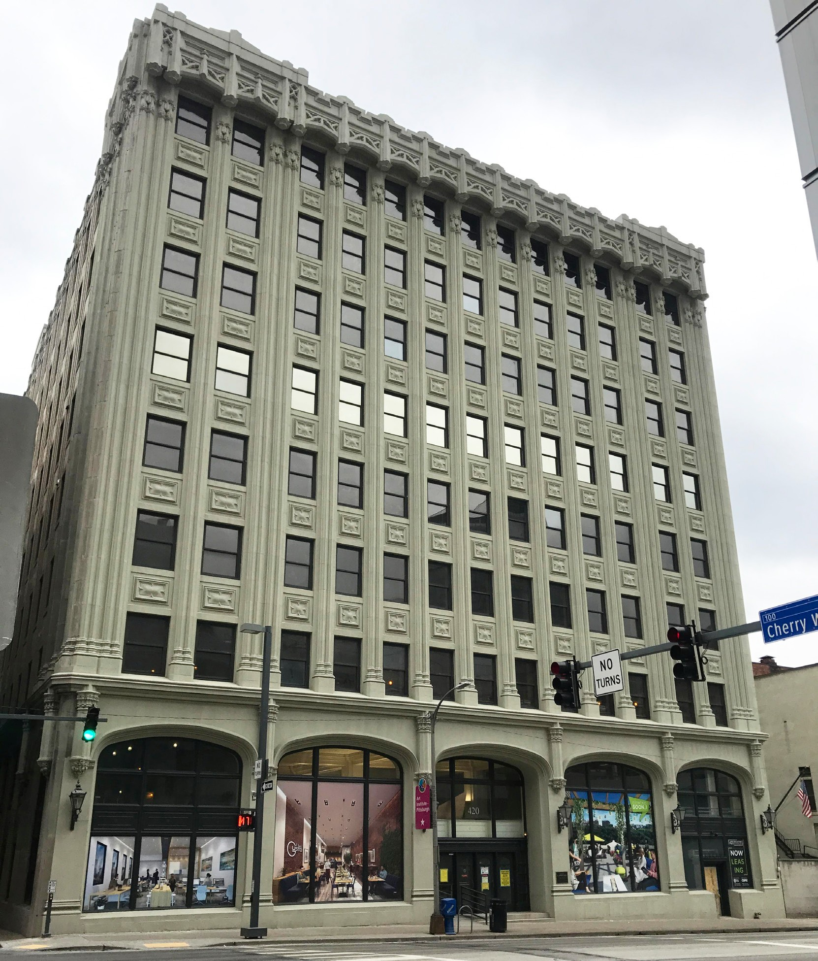
420 Blvd of the Allies
General
Center for Innovation and Entrepreneurship
Housing
Real Estate
Engineering and Construction
Executive

Slide 11

420 Blvd of the Allies
General
Center for Innovation and Entrepreneurship
Housing
Real Estate
Engineering and Construction
Executive

Slide 12
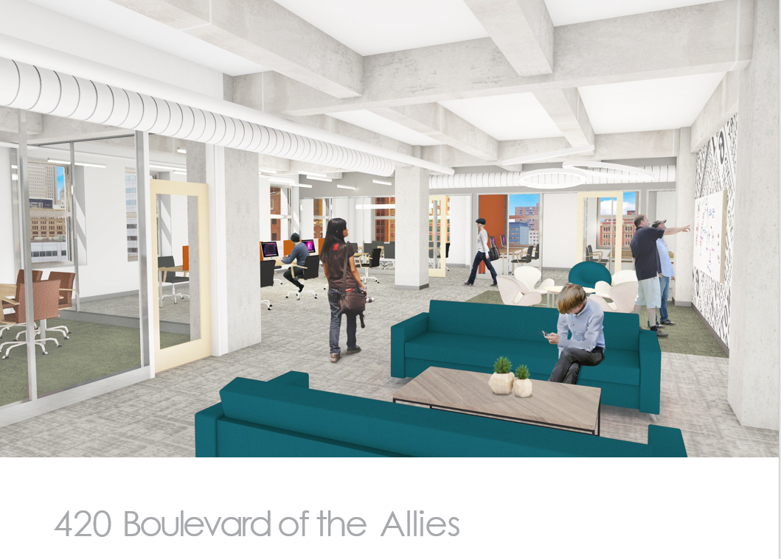
420 Blvd of the Allies
General
Center for Innovation and Entrepreneurship
Housing
Real Estate
Engineering and Construction
Executive

Slide 13
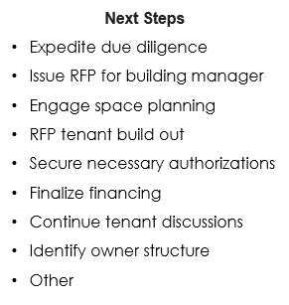
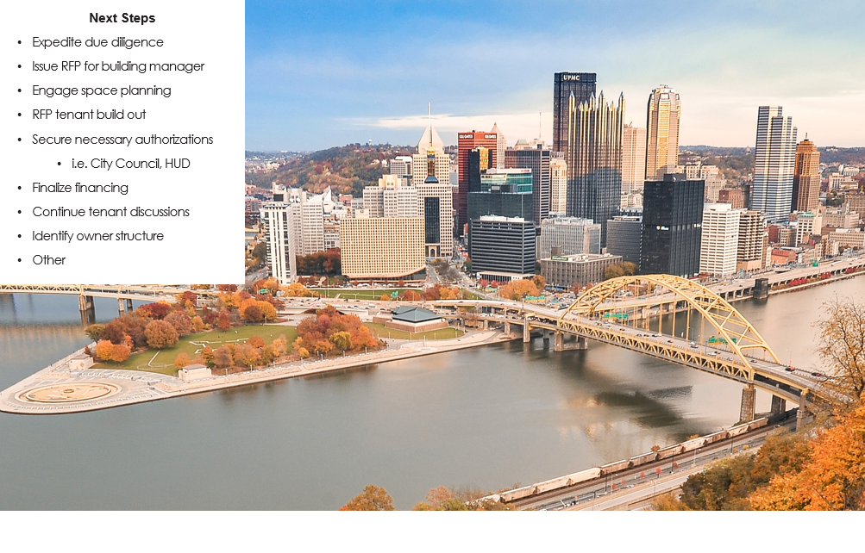
General
Announcements
Center for Innovation and Entrepreneurship
Housing
Real Estate
Engineering and Construction
Executive

